Slide 1
Technical service manual for Aqua-X series (Inverter&R32)

Slide 2
Trouble Shooting
Part 1 (Error code):
1- Electronic system failure
2- Gas Piping system failure
3- Water system failure
4- Temperature sensor failure
5- Non-failure protection
Part 2 (Common failure, no error code):
1- HP no heating
2- Defrosting
3- Controller no display

Slide 3
1. Electronic system failure
Error code | Description | Suggested solution
F1 | Compressor drive module failure | Single phase: Replace Integrated board Three-phase: A. Wiring B. Contactor C. Inverter board D. PC board
F2 | PFC module failure | Single phase: Replace Integrated board Three-phase: A. Inverter board B. PC board
F3/F4 | Compressor start /running failure | A. Compressor wiring B. Integrated board/Inverter board (for three-phase model) C. Compressor
F5/F6 | Inverter board over current /overheat protection | Single phase: A. Wiring B. Integrated board Three-phase: A. Wiring B. Inverter board C. PC board
F7 | Current protection | Single phase: A. Power off and restart B. Integrated board C. Compressor Three-phase: A. Power off and restart B. Inverter board C. Compressor
F8 | Cooling plate overheat protection | A. Power off and restart B. Check fan motor C. Check cooling plate
F9 | Fan motor failure | A. Wiring B. Replace Integrated board/PC board (for three-phase model) C. Replace fan motor
FA | PFC module over current protection | A. Power off and restart B. Replace Integrated board/Inverter board (for three-phase model)
Fb | Capacitor no charging protection | Single phase: Replace Integrated board Three-phase: Replace Capacitors plate
P0 | Controller communication failure | A. Wiring B. Replace LED controller C. Replace Integrated board/PC board (for three-phase model)
PA | Restart memory failure | Replace Integrated board/PC board (for three-phase model)
E4 | Phases lack protection (three phase model only) | Single phase: Check dip switch Three-phase: A. Power supply B. Wiring C. Power filter plate D. Capacitors

Slide 4
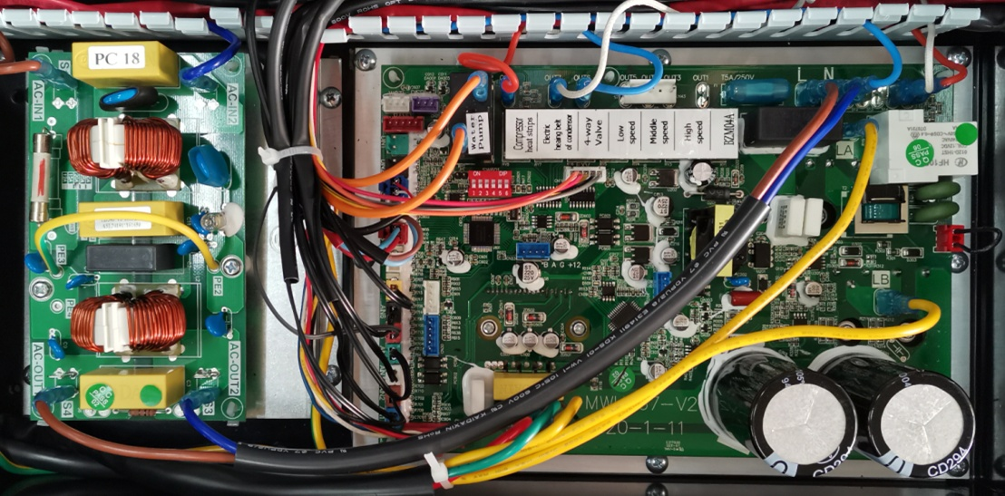
Electronic System
Integrated board
Power filter plate
Note: Integrated board include Inverter board & PC board

Slide 5
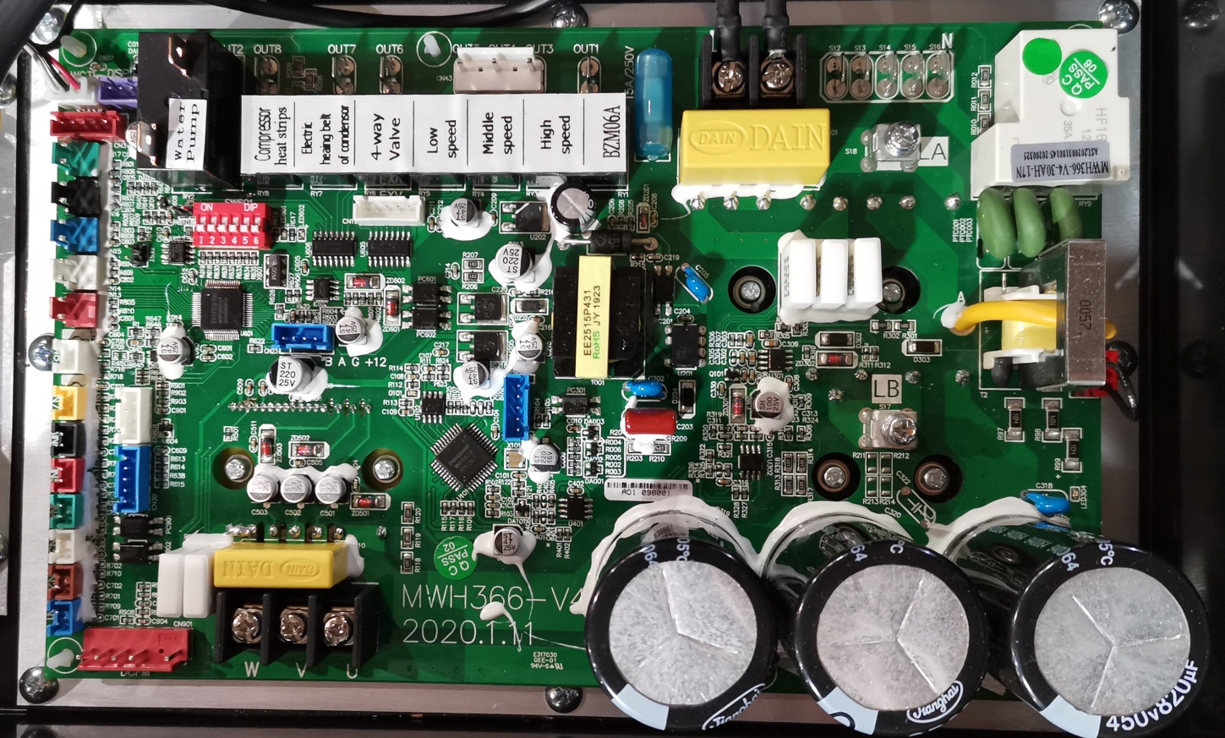
Integrated board terminal introduction
U V W: connect to compressor
DCFM: connect to DC motor
AIN1: water inlet temp sensor (blue) AIN5: Gas exhaust temp sensor (red)
AIN2: water outlet temp sensor (brown) AIN6: Gas return temp sensor (black)
AIN3: Heating coil pipe (evaporator) temp sensor (white) AIN7: Ambient temp sensor failure (yellow)
AIN4: Cooling coil pipe (heat exchanger) temp sensor (green)
PS: the color of temp sensor plug is in accordance with the color of terminals on Integrated board
Connect to reactor
DIN5: Connect to high pressure switch（red）
DIN4: Connect to low pressure switch（white）
DIN3: Connect to water flow switch（blue）
DIN2: optional for external control
（black）
WCTIL: Connect to LED controller（white）
AC-N: Neutral line
OUT6: connect to 4-way valve
KY2: water pump relay
AC-L: live line
OUT8: connect to compressor heat strips
OUT7: connect to evaporator heating belt

Slide 6
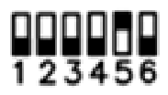
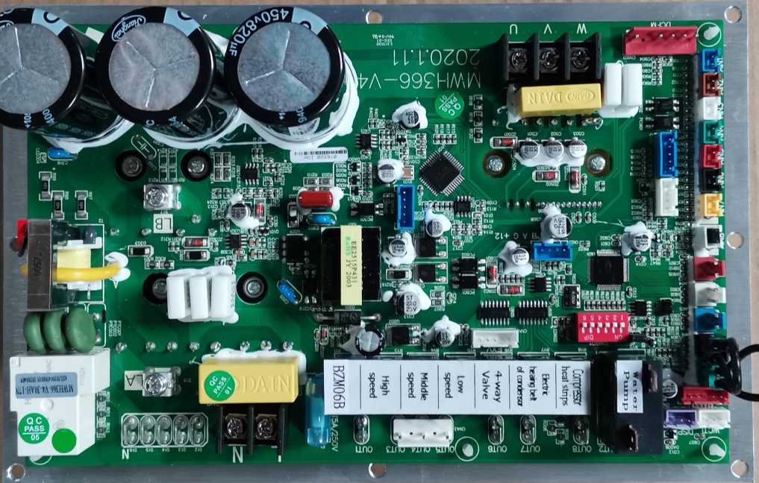




A. DIP switch adjustment illustration for heating only models (Single phase)
NOTE:
Any Inverter HP, before replacing PC board, please adjust 6-bit code on the DIP switch according to below data.
Please pay high attention, NO adjustment or WRONG adjustment will lead to following error:
1. Compressor failure or Compressor driver module failure.
2. Overcurrent protection (Error code: F7).
3. Phase lack protection (Error code: E4).
 | AXR13
 | AXR17
 | AXR21
 | AXR26
 | AXR32
AIN8 Disconnect
JP1 Connect
DIN1 Disconnect

Slide 7
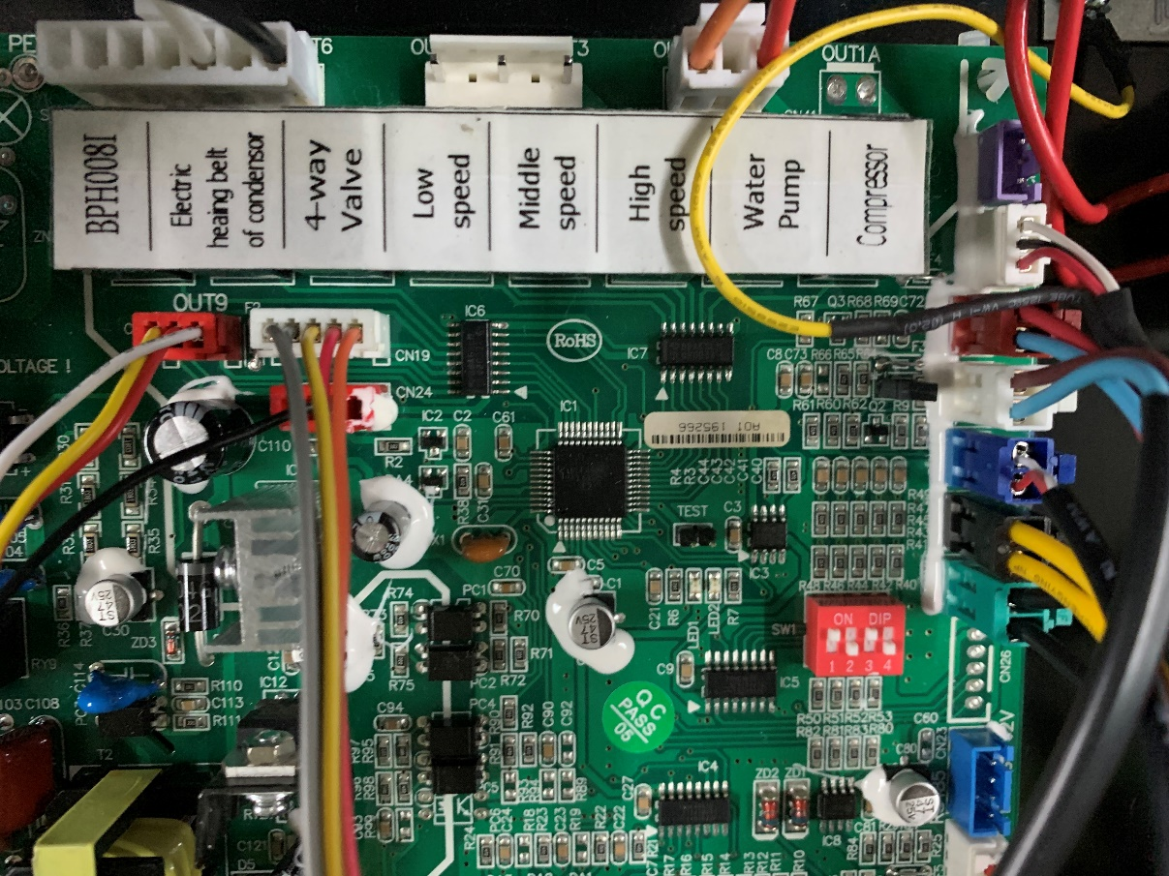


B. DIP switch adjustment illustration for heating only models (Three-phase)
NOTE:
Any Inverter HP, before replacing PC board, please adjust 4-bit code on the DIP switch according to below data.
Please pay high attention, NO adjustment or WRONG adjustment will lead to following error:
1. Compressor failure or Compressor driver module failure.
2. Overcurrent protection (Error code: F7).
 | AXR32T
 | AXR40T
DIN1 Disconnection

Slide 8
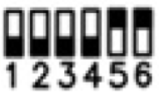
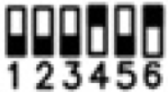
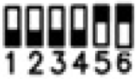
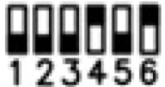
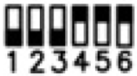
C. DIP switch adjustment illustration for heating & cooling models (Single phase)
NOTE:
Any Inverter HP, before replacing PC board, please adjust 6-bit code on the DIP switch according to below data.
Please pay high attention, NO adjustment or WRONG adjustment will lead to following error:
1. Compressor failure or Compressor driver module failure.
2. Overcurrent protection (Error code: F7).
3. Phase lack protection (Error code: E4).
 | AXCR13
 | AXCR17
 | AXCR21
 | AXCR26
 | AXCR32
AIN8 Disconnect
JP1 Connect
DIN1 Disconnect

Slide 9


D. DIP switch adjustment illustration for heating & cooling models (Three-phase)
NOTE:
Any Inverter HP, before replacing PC board, please adjust 4-bit code on the DIP switch according to below data.
Please pay high attention, NO adjustment or WRONG adjustment will lead to following error:
1. Compressor failure or Compressor driver module failure.
2. Overcurrent protection (Error code: F7).
 | AXCR32T
 | AXCR40T
DIN1 Disconnection

Slide 10
F1 Solution
Display F1
Compressor driver module failure
Single phase model
Three-phase model
Replace Integrated board
A. Wiring
C. Inverter board
D. PC board
B. Contactor
Warning: When conducting below operation, heat pump must be powered off !

Slide 11
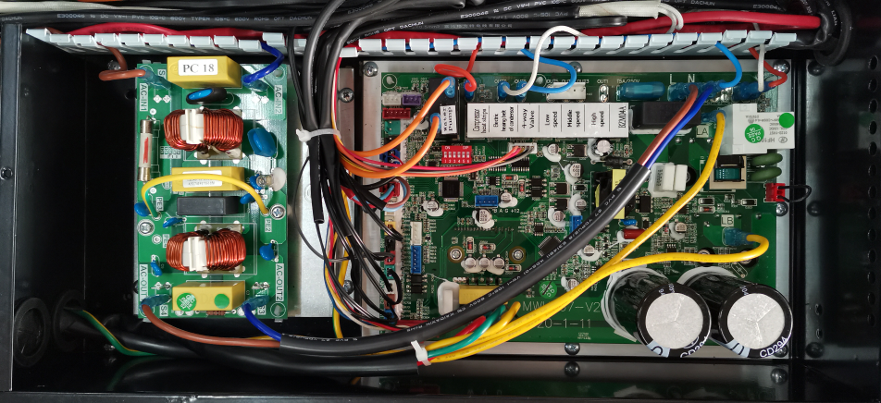
Single phase model:
Replace Integrated board.
Integrated board

Slide 12
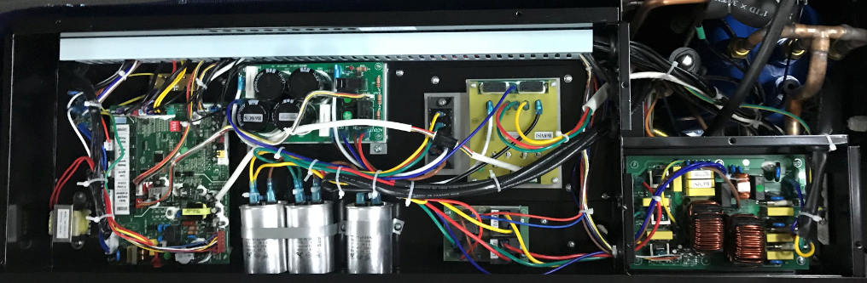
Three-phase model:
Step 1: Checking wiring
Check if wiring on Inverter board is well connected.
Connector
If problem still exist, go to step 2.

Slide 13
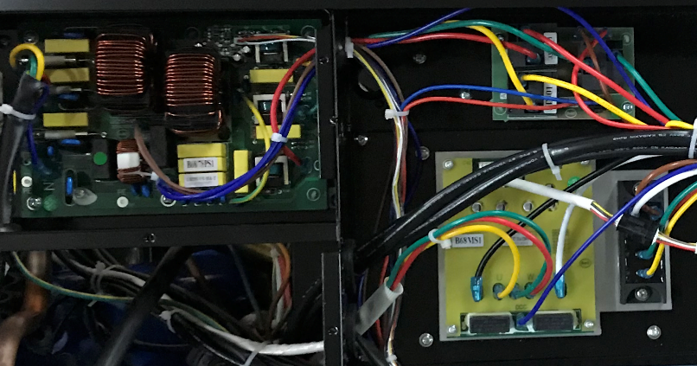
Step 2: Check if the contactor is normal.
1）If OUT1 on PC board has 230V output
2）If there is 400V of any two wiring between power filter plate and 3phase replay.
3）If there is 400V of any two wiring between 3phase replay and compressor capacitor.
400V between any two wiring
230V between too wiring
400V between any two wiring
This operation should be conducted with power connected, must be operated by professionals!
If problem still exist, go to step 3.

Slide 14
Step 3: If problem still exsit, replace Inverter board.
Inverter board
If problem still exist, go to step 4.

Slide 15
Step 4: If problem still exsit, replace PC board.
PC board

Slide 16
F2 Solution
Display F2
PFC module failure
Single phase model
Three-phase model
Replace Integrated board
A. Inverter board
B. PC board
Warning: When conducting below operation, heat pump must be powered off !

Slide 17
Single phase model:
Replace Integrated board.
Integrated board

Slide 18
Three-phase model:
Step 1: Replace Inverter board.
Inverter board
If problem still exist, go to step 2.

Slide 19
Step 2: If problem still exsit, replace PC board.
PC board

Slide 20
F3/F4 Solution
Display F3: Compressor start failure
Display F4: Compressor running failure
Single phase model/Three-phase model
A. Compressor wiring
C. Compressor
B. Integrated board/Inverter board (for three-phase model)
B. Starting/running current
A. Compressor resistance
Warning: When conducting below operation, heat pump must be powered off !

Slide 21
Single phase model:
Step 1: Checking wiring
Check if wiring between compressor and Integrated board is well connected.
Terminals: U-V-W
Terminals: U-V-W
If problem still exist, go to step 2.

Slide 22
Step 2: If well connected, replace Integrated board.
Integrated board
If problem still exist, go to step 3.

Slide 23
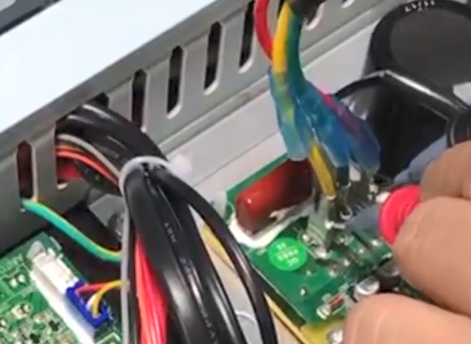
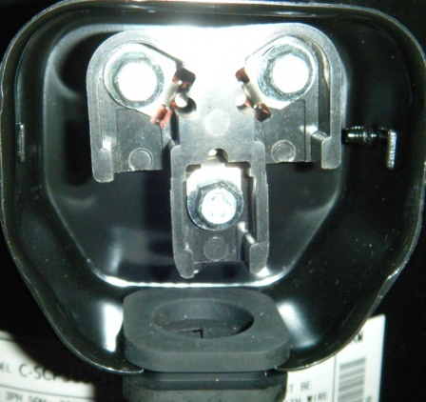
3. Check the resistance and starting/running current of compressor.
A. Check if resistance values between any two terminals is the same, like U and V, U and W, V and W.
If resistance value is not the same, that means compressor failure and replace compressor.
Terminals: U-V-W

Slide 24
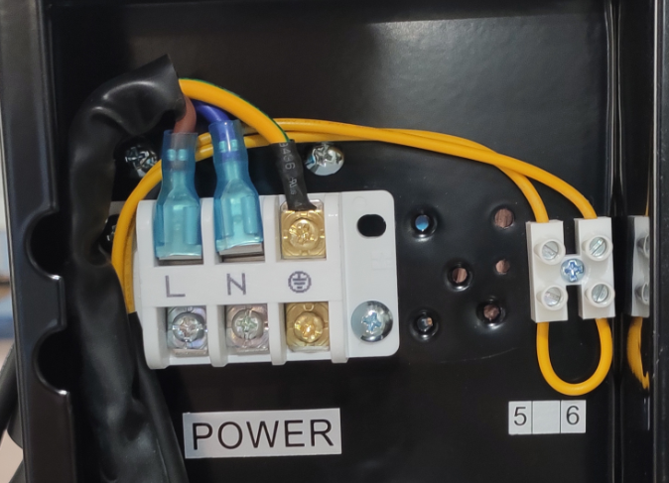
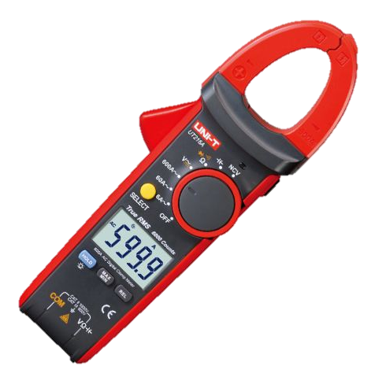
B. Check if the starting/running current is normal.
(Let the live wire pass through the jaws)
Note: If starting current increases abnormally, it is failure and needs to be replaced.
Single phase model

Slide 25
Three-phase model:
Step 1: Checking wiring.
Check if wiring between compressor and Inverter board is well connected.
Terminals: U-V-W
Terminals: U-V-W
If problem still exist, go to step 2.

Slide 26
Step 2: If well connected, replace Inverter board.
Inverter board
If problem still exist, go to step 3.

Slide 27
Step 3: Check the resistance and starting/running current of compressor.
A. Check if resistance values between any two terminals is the same, like U and V, U and W, V and W.
Terminals: U-V-W
If resistance value is not the same, that means compressor faiure and replace compressor.

Slide 28
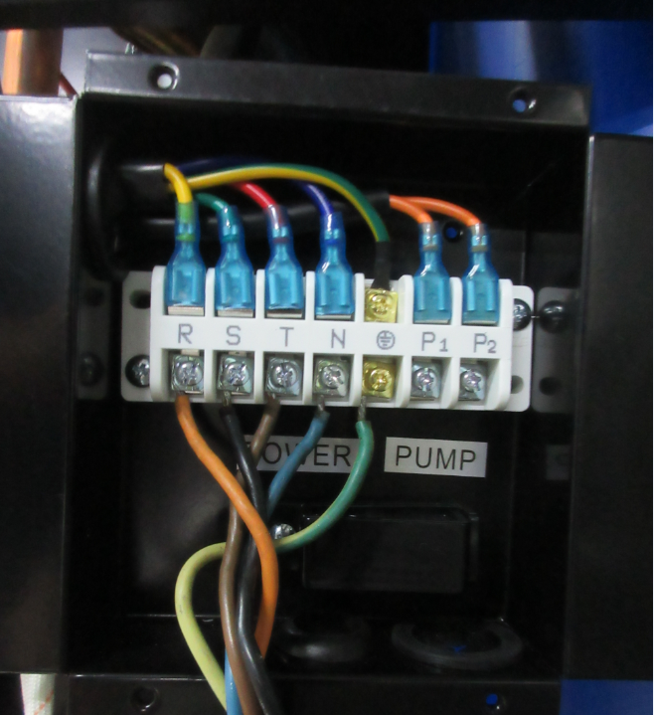
B. Check if the starting/running current is normal.
(Let the live wire (one of RST) pass through the jaws)
Note: If starting current increases abnormally, it is failure and needs to be replaced.
Three-phase model

Slide 29
F5/F6 Solution
Display F5: Inverter board over current protection
Display F6: Inverter board overheat protection
Single phase model
Three-phase model
A. Wiring
A. Wiring
B. Integrated board
B. Inverter board
C. PC board
Warning: When conducting below operation, heat pump must be powered off !

Slide 30
Single phase model:
Step 1: Checking wiring.
Check if wiring between compressor and Integrated board is well connected.
Terminals: U-V-W
Terminals: U-V-W
If problem still exist, go to step 2.

Slide 31
Step 2: If well connected, replace Integrated board.
Integrated board
If problem still exist, go to step 3.

Slide 32
Three-phase model:
Step 1: Checking wiring
Check if wiring on Inverter board is well connected
Connector
If problem still exist, go to step 2.

Slide 33
Step 2: If problem still exsit, replace Inverter board.
Inverter board
If problem still exist, go to step 3.

Slide 34
Step 3: If problem still exsit, replace PC board.
PC board

Slide 35
F7 Solution
Display F7
Current protection
Single phase model
Three-phase model
A. Power off and restart
B. Integrated board
C. Compressor
A. Power off and restart
B. Inverter board
C. Compressor
If current is over max setting value, F7 will display.
Normally when current reach max setting value, the HP will run by lower frequency.
Restart at least 5 minutes after disconnection.
Warning: When conducting below operation, heat pump must be powered off !

Slide 36
Single phase model:
Step 1: Power off and restart
Restart at least 5minutes after disconnection of power.
Step 2: If F7 still exist, replace Integrated board.
If problem still exist, go to step 3.
Integrated board

Slide 37
Step 3. Check the resistance and starting/running current of compressor.
A. If issue still exist, check if resistance values between any two terminals is the same, like U and V, U and W, V and W.
If resistance value is not the same, that means compressor faiure and replace compressor.
Terminals: U-V-W

Slide 38
B. Check if the starting/running current is normal.
(Let the live wire pass through the jaws)
Note: If starting current increases abnormally, it is failure and needs to be replaced.

Slide 39
Step 1: Power off and restart
Restart at least 5 minutes after disconnection of power. If problem still exist, go to step 2.
Step 2: If F7 still exist, replace Inverter board.
Inverter board
If problem still exist, go to step 3.

Slide 40
Step 3. Check the resistance and starting/running current of compressor.
A. If issue still exist, check if resistance values between any two terminals is the same, like U and V, U and W, V and W.
If resistance value is not the same, that means compressor faiure and replace compressor.
Terminals: U-V-W
If resistance value is not the same, that means compressor faiure and replace compressor.

Slide 41
B. Check if the starting/running current is normal.
(Let the live wire (one of RST) pass through the jaws)
Note: If starting current increases abnormally, it is failure and needs to be replaced.
Three-phase model

Slide 42
F8 Solution
Display F8
Cooling plate overheat protection
Single phase model/Three-phase model
A. Power off and restart
B. Check fan motor
C. Check cooling plate
Alarm: Temp of cooling plate:
Cooling ≥ 85 ℃ ，heating ≥ 75 ℃
1. Switch off at least 5 mins and the temp of cooling plate≤50℃.
2. Check the fan motor is running well or not.
3. Check if there is much accumulated dust on cooling plate, if yes, please clean it.

Slide 43
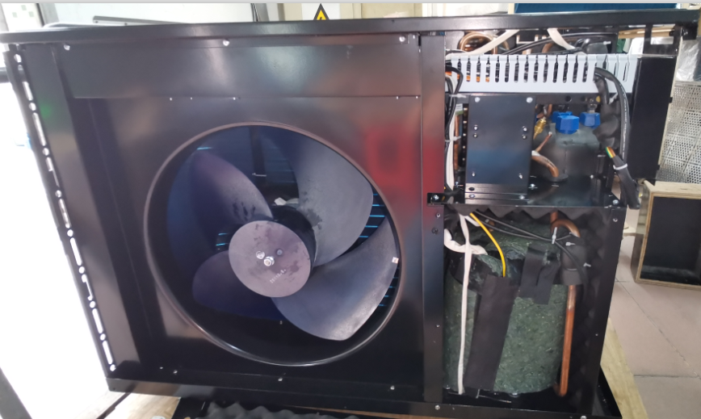
Step 1: Power off and restart
Restart at least 5 minutes after disconnection of power
Step 2: If still F8, please check the fan is running normally
Fan
If problem still exist, go to step 2.

Slide 44
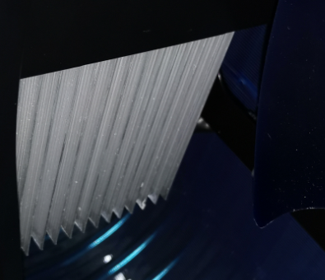
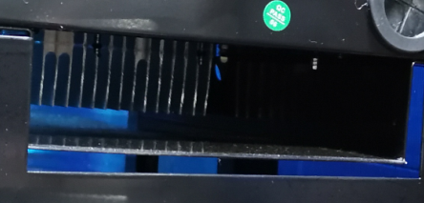
Step 3: If still F8, please check the cooling plate if it is full of dust
Cooling plate

Slide 45
F9 Solution
Display F9
Fan motor failure
A. Wiring
B. Replace Integrated board
Single phase model
C. Replace fan motor
Three-phase model
A. Wiring
B. Replace PC board
C. Replace fan motor
Warning: Every step must be conducted after heat pump is power off and
LED light on capacitor plate is completely off.

Slide 46
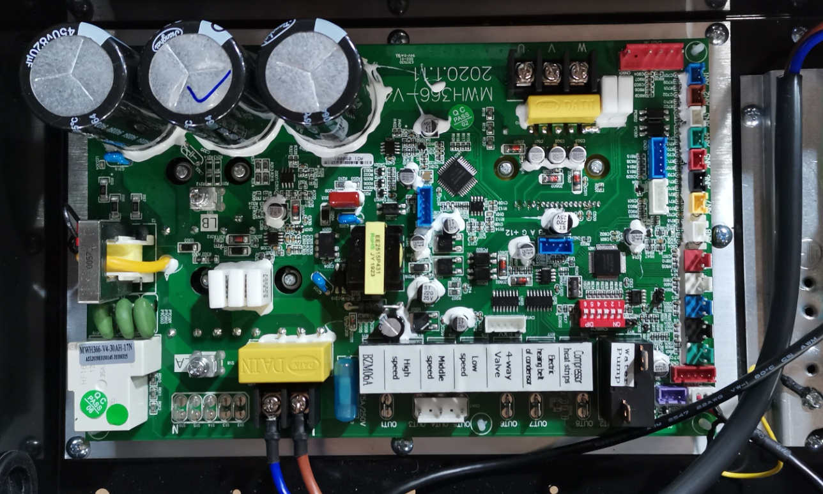
Single phase model:
Step 1: Checking wiring.
Check if DCFM terminals is well connected.
DCFM: 5pin terminal connect to DC fan motor
If problem still exist, go to step 2.

Slide 47
Step 2: If wiring is well connected, replace Integrated board.
Integrated board
If problem still exist, go to step 3.

Slide 48
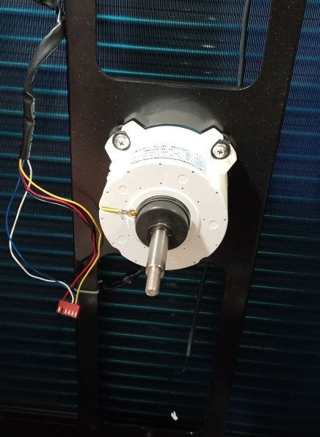
Step 3: If F9 still exist, replace fan motor.
Fan motor

Slide 49
Three-phase model:
Step 1: Checking wiring
Check if DCFM & JP1 terminals are well connected
Terminal: JP1
DCFM: 5pin terminal for fan driver module
If problem still exist, go to step 2.

Slide 50
Step 2: If wiring is well connected, replace PC Board.
PC board
If problem still exist, go to step 3.

Slide 51
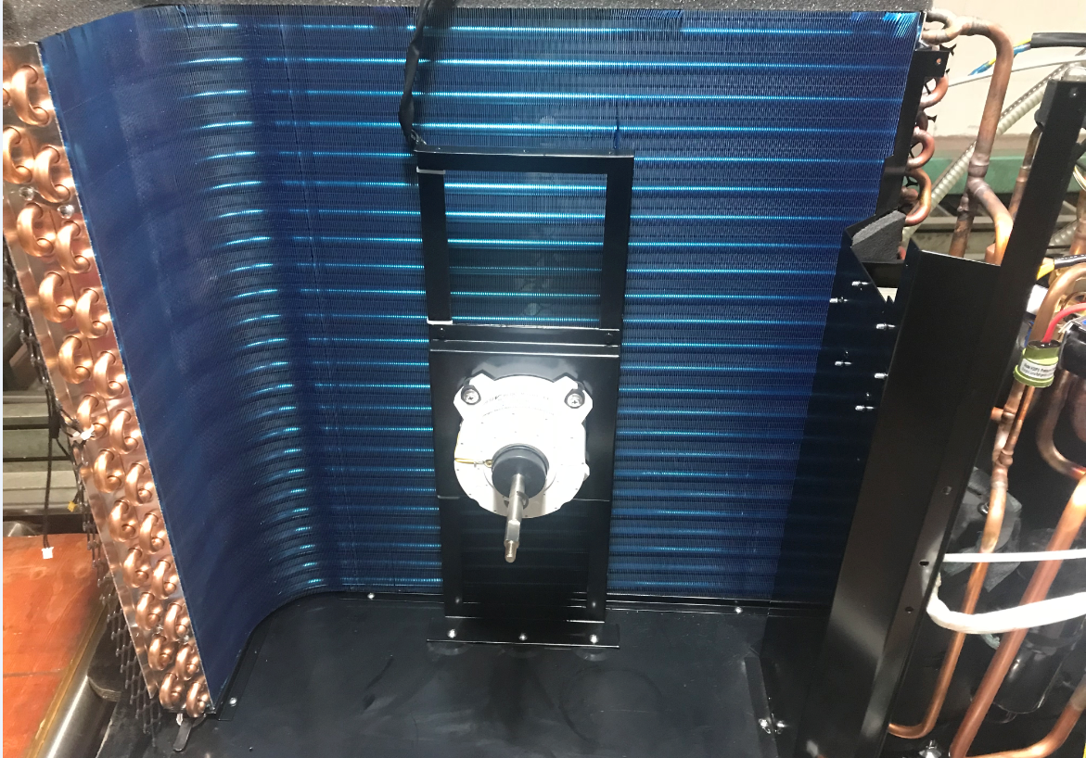
Step 3: If F9 still exist, replace fan motor.
Fan motor

Slide 52
FA Solution
Display FA
PFC module over current protection
A. Power off and restart
B. Replace Integrated board
Single phase model
Three-phase model
A. Power off and restart
B. Replace Inverter board
Restart the HP at least 5 minutes after turning off
Warning: When conducting below operation, heat pump must be powered off !

Slide 53
Single phase model:
Step 1: Restart the HP at least 5 minutes after turning off.
Step 2: replace Inverter board.
Integrated board

Slide 54
Three-phase model:
Step 1: Restart the HP at least 5 minutes after turning off.
Step 2: Replace Inverter board.
Inverter board

Slide 55
Fb Solution
Display Fb
Capacitor no charging protection
Replace Integrated board
Single phase model
Three-phase model
Replace Capacitors plate
Warning: When conducting below operation, heat pump must be powered off !

Slide 56
Single phase model:
Replace Integrated board.
Integrated board

Slide 57
Three-phase model:
Replace Capacitors plate.
Capacitors plate

Slide 58
P0 Solution
Display P0
Controller communication failure
A. Wiring
Single phase model
Three-phase model
A. Wiring
B. Replace controller
C. Replace Integrated board
B. Replace controller
C. Replace PC board
Warning: When conducting below operation, heat pump must be powered off !

Slide 59
Single phase model:
Step 1: Checking wiring
Check if wiring between controller and Integrated board Board is well connected.
WCTIL wiring on Integrated board(white color)
If well connected, go to step 2.

Slide 60
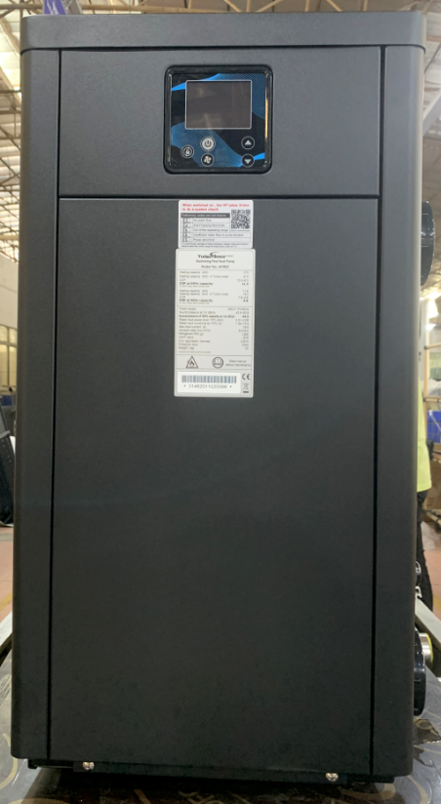
Step 2: Replace controller.
Controller
If problem still exist, go to step 3.

Slide 61
Step 3: Replace Integrated board.
Integrated board

Slide 62
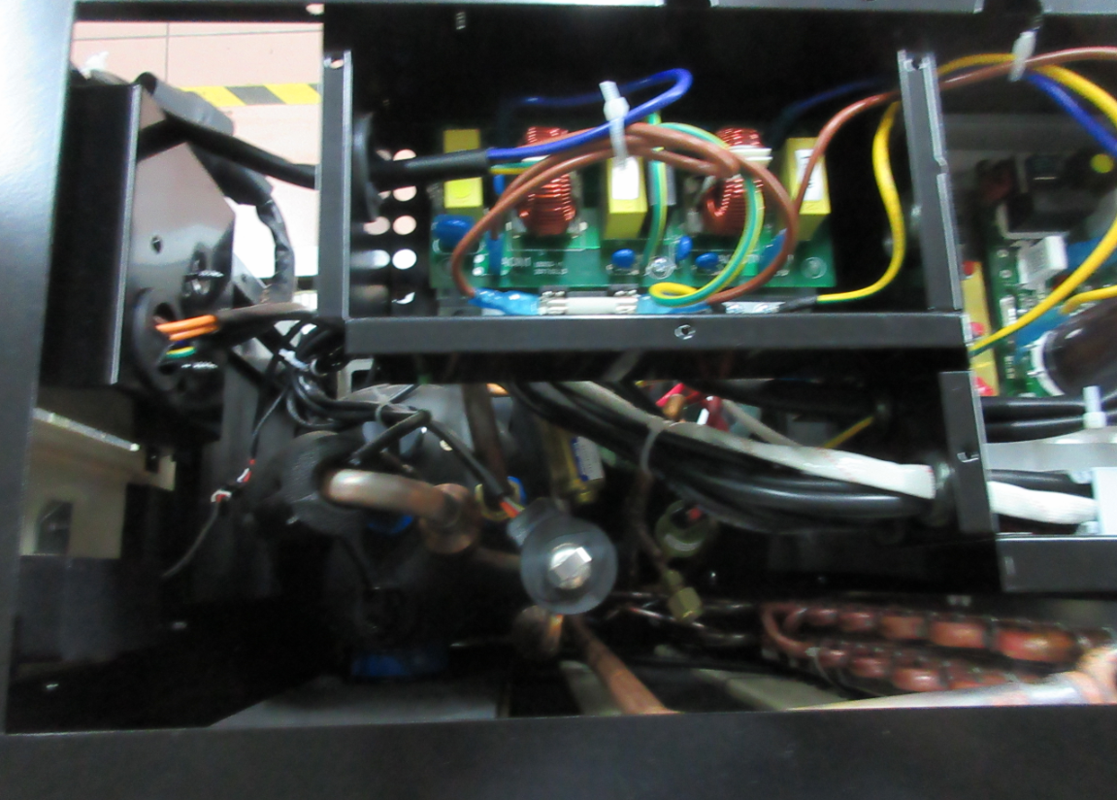
Three-phase model:
Step 1: Checking wiring
Check if wiring between controller and PC board is well connected.
WCTIL wiring on PC board(white color)
The wiring connector between controller and PC board: above heat exchanger
If well connected, go to step 2.

Slide 63
Step 2: Replace controller.
Controller
If problem still exist, go to step 3.

Slide 64
Step 3: Replace PC board.
PC board

Slide 65
PA Solution
Display PA
Restart memory failure
Replace Integrated board
Single phase model
Three-phase model
Replace PC board
Warning: When conducting below operation, heat pump must be powered off !

Slide 66
Single phase model:
Replace Integrated board.
Integrated board

Slide 67
Three-phase model:
Replace PC board.
PC board

Slide 68
E4 Solution
Display E4
Phases lack protection
(three-phase model only)
Check dip switch
Single phase model
Three-phase model
A. Power supply
B. Wiring
C. Power filter plate
D. Capacitors
Warning: When conducting below operation, heat pump must be powered off !

Slide 69
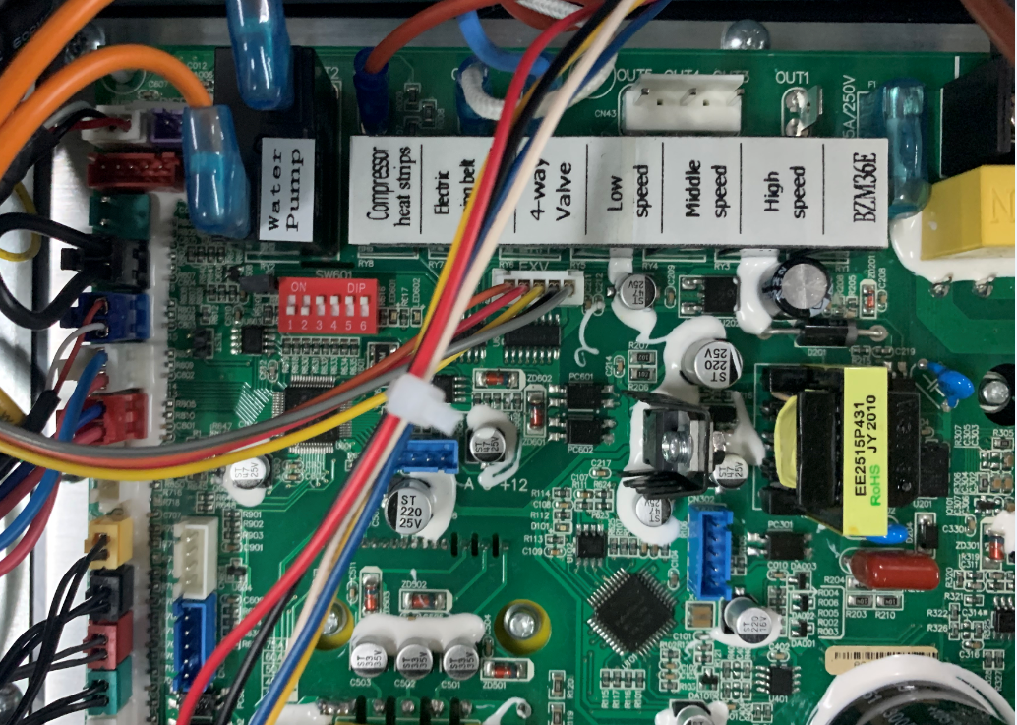
Single phase model:
Check if dip switch is correct.
Dip switch

Slide 70
Three-phase model:
Step 1. check if power supply is normal.
Please check if the voltage of R-N, S-N and T-N are 230V/AC. If it is OK, please go to step 2.

Slide 71
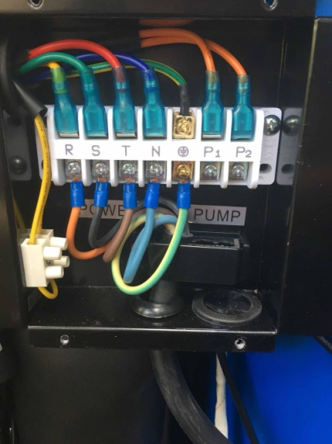
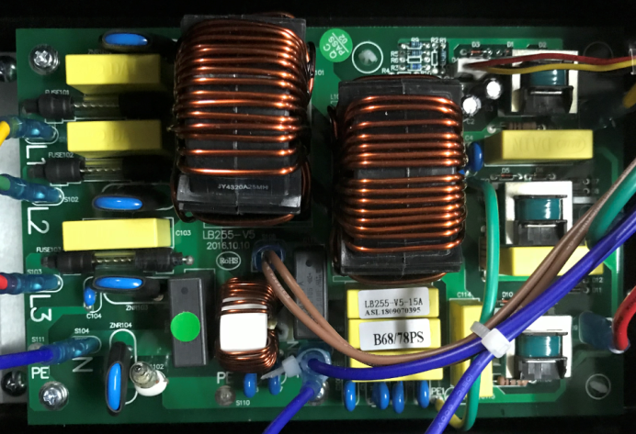
Step 2. check if wiring is well connected.
Please check if the wiring between power cord, terminal plate and power filter plate is well connected. If it is OK, please go to step 3.
Terminal plate
Power filter plate
S
Earth line
R
Neutral line
T

Slide 72
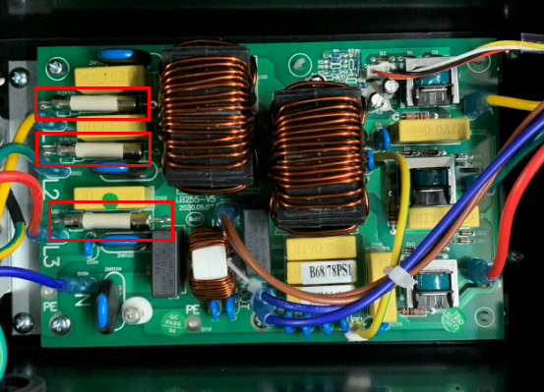
Step 3. check if power filter plate is failure.
Please check if three fuses on power filter plate are melted, if yes, replace fuse, if not, replace power filter plate (as shown in the picture).
Power filter plate
Three fuses

Slide 73
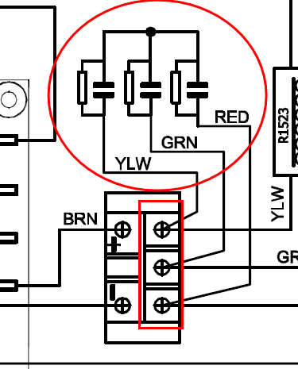
Step 4. Disconnect the capacitors.
Please check if the heat pump is running properly after disconnecting the capacitors.(Disconnect the wiring (Yellow, Green, Red) from the terminal plate)
Terminal plate
Capacitors

Slide 74
2. Piping system failure
Error code | Description | Solution
E1 | High pressure protection | A. Installation condition B. Water pump C. Wiring D. High pressure switch E. Check EEV
E2 | Low pressure protection | A. Wiring B. Detect gas leakage C. Low pressure switch D. Check EEV
E8 | High exhaust temp protection | A. Installation condition B. Water pump C. Detect gas leakage D. Gas exhaust temp sensor
EA | Evaporator overheat protection (only at cooling mode) | A. Installation condition B. Fan C. Fan motor

Slide 75
Display E1
High pressure protection
Single phase model/Three-phase model
2. Water pump
3. Integrated board/PC board wiring
1. Installation condition
5. Electronic expansion valve
4. High pressure switch
E1 Solution
Warning: When conducting below operation, heat pump must be powered off !

Slide 76
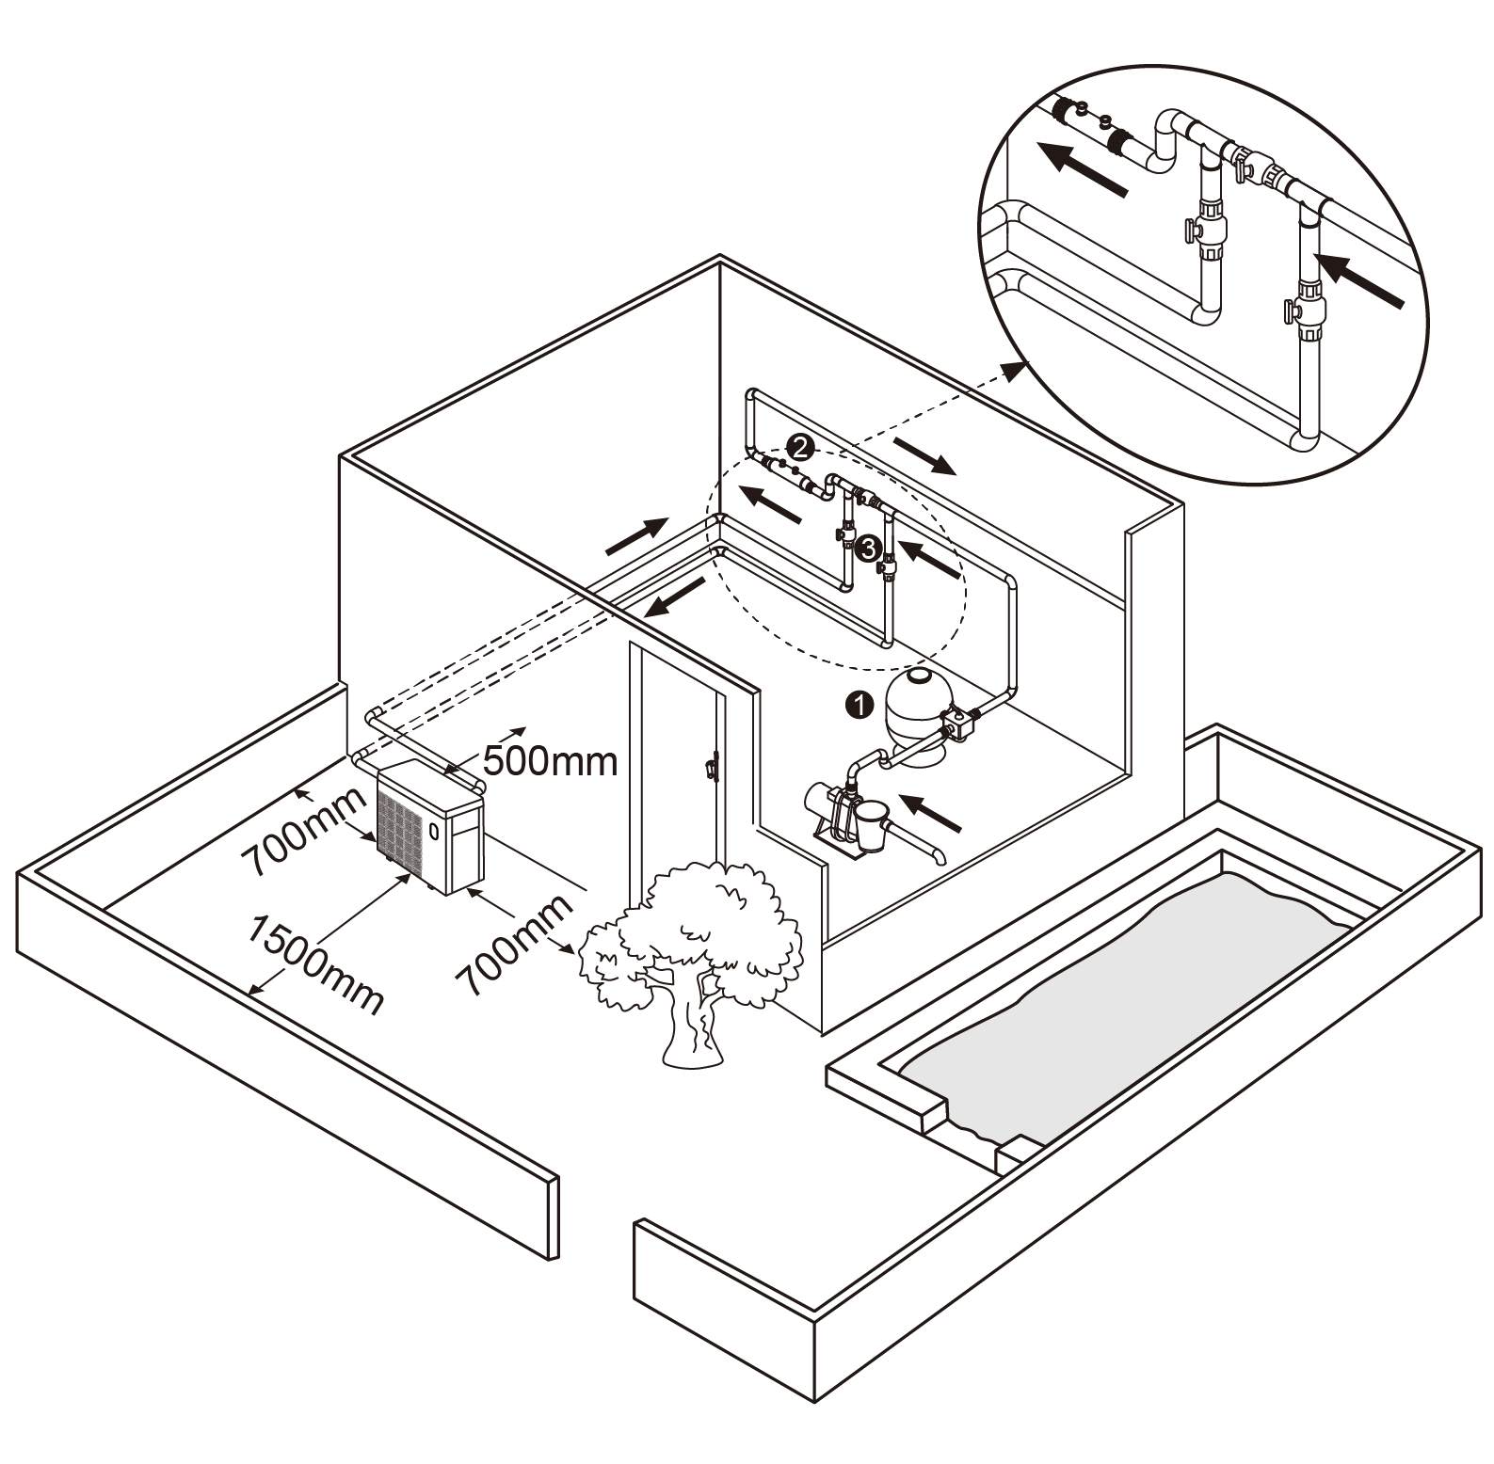
Step 1: Check the installation is good enough for air circulation.
1) Check if heat pump is installed according to required distance；
2) Check if heat pump evaporator fins are blocked
If installation condition is good, go to step 2.

Slide 77

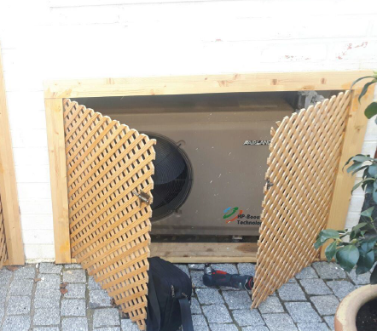
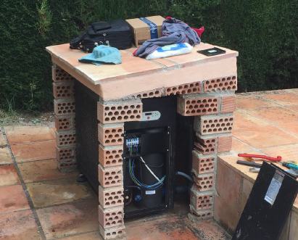
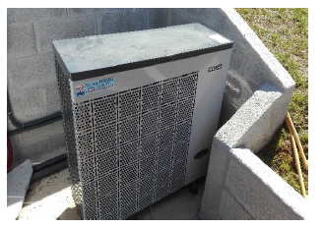
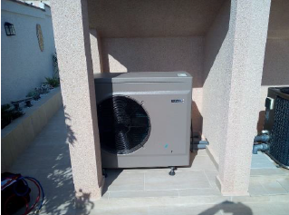
Bad installation condition

Slide 78
Step 2: Check if water pump is working normally.
Water pump：
A. Check if water pump is running well.
B. Check if water flow is sufficient.
C. Check if water pump is blocked.
D. Check if water pump valve is fully opened.
Step 3: Check if wiring between Integrated board and high pressure switch is well connected. (Single phase model)
High pressure switch terminal DIN5 (Red color)

Slide 79
Step 3: Check if wiring between PC board and high pressure switch is well connected. (Three phase-phase model)
High pressure switch terminal DIN5 (Red color)
If well connected, go to step 4.

Slide 80
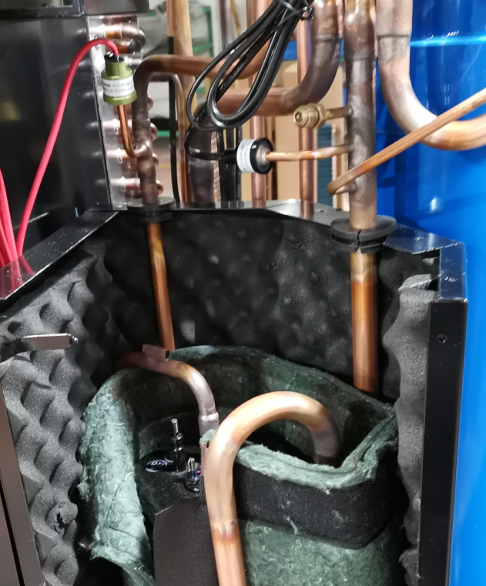
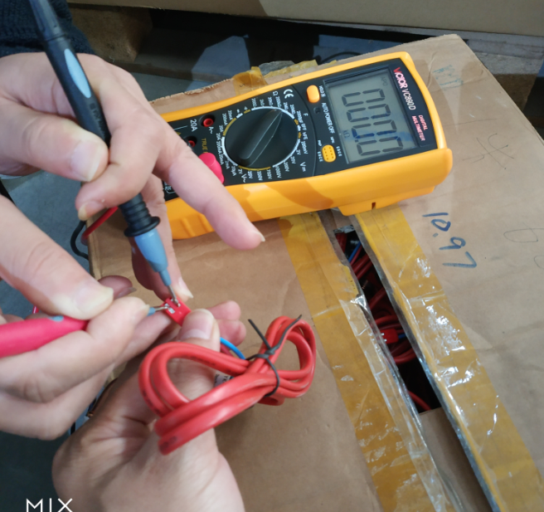
Step 4: Check if the resistance of high pressure switch is 0 or close to 0, if the value is infinity, replace high pressure switch.
High pressure switch
If well connected, go to step 5.

Slide 81
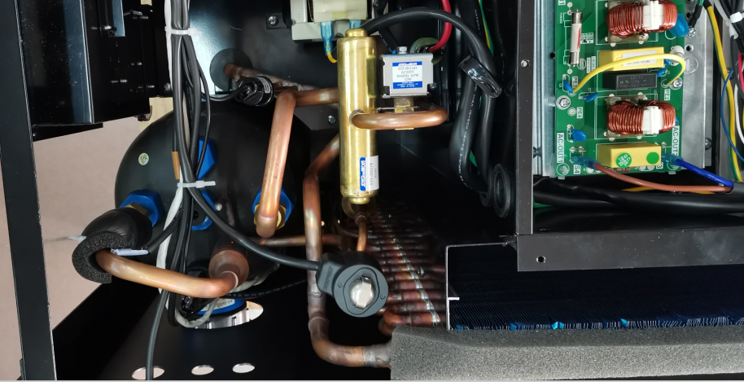
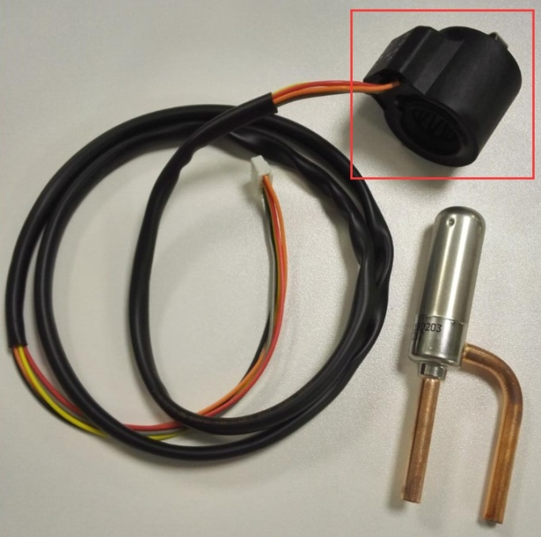
Step 5. Replace winding of electric expansion valve
If problem still exist, please check expansion valve if any rusty or damaged inside the winding, replace winding if rusty. If still any frost found on the valve body, replace the valve body
Winding
Valve body
Note: If winding failure, then gas flow volume would be abnormal in the system, E1 or E2 may display at the same unit.

Slide 82
Caution: High pressure switch need to be check or not?
It depends on when E1 occur.
If E1 occur once the unit power on,
that means high pressure switch is not well connected
or possibly failure.
If E1 occur after the unit run for some time(a few minutes),
that means high pressure switch works normally to protect
the unit.

Slide 83
E2 Solution
Display E2
Low pressure protection
Single phase model/Three-phase model
1. Wiring
2. Gas leakage
3. Low pressure switch

Slide 84
Step 1. Check wiring
Single phase model:
Check if wiring between low pressure switch and Integrated board is well connected.
Low pressure switch terminal DIN4
If well connected, go to step 2.

Slide 85
Step 1. Check wiring
Three-phase model:
Check if wiring between low pressure switch and PC board is well connected.
Low pressure switch terminal DIN4
If well connected, go to step 2.

Slide 86
Step 2. Check if it is Gas leakage
A. Check low pressure value if it is lower than 0.05Mpa.
Inverter Pool HP High & Low Reference Pressure (R32)
 | Air℃ | Humidity% | Water inlet ℃ | Water outlet℃ |  | Low pressure（Mpa）
Heating | 15 | 12 | 26 | 28 | 100% Capacity | 0.67-0.8
 |  |  |  |  | 80% Capacity | 0.8-1.0
Cooling | 35 | 24 | 28 | 26 | 100% Capacity | 0.9-1.0
Normal ambient temp:
When detecting gas, heat pump must be running at least 5 minutes, the pressure value will vary according to air temp, please refer to pressure data form.
When pressure value is 10% lower than reference pressure value, gas should be insufficient.
If low pressure value is too low, pls go to Point B & Point C.
If low pressure value is normal, skip to step 4.

Slide 87
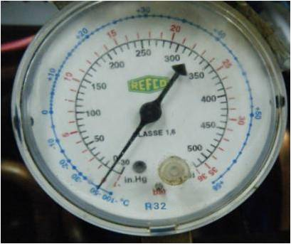
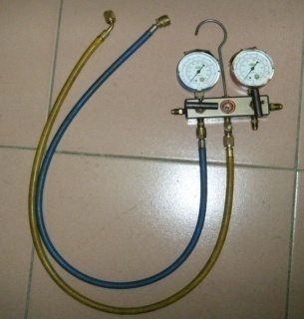
Tools
Gas filling port
Low pressure valve
High pressure gauge
Low pressure gauge
High pressure valve
Initial reading is 0

Slide 88
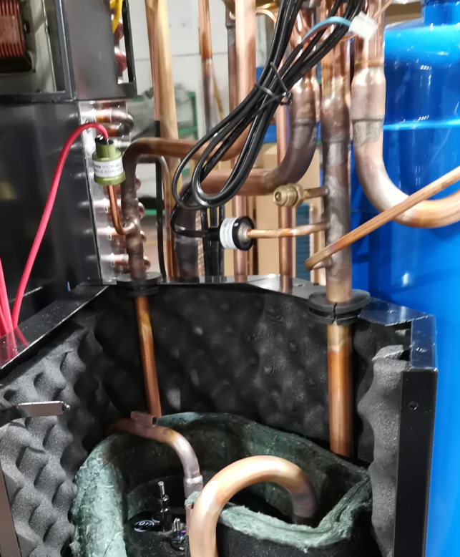
Low pressure detecting port
Compressor gas return port is
for low pressure detection

Slide 89
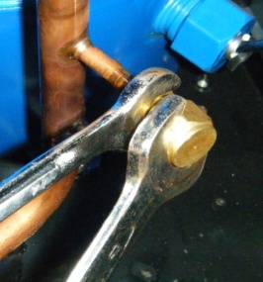
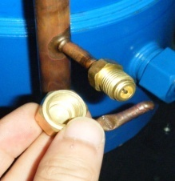
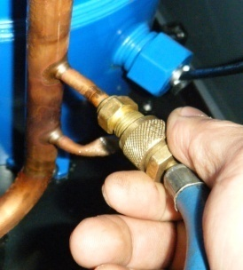
Detecting method
Take off copper nut
Attention:
Must use two spanners, otherwise the
pipe might be broken due to overexertion
Connect pressure gauge to low
pressure valve and twist well

Slide 90
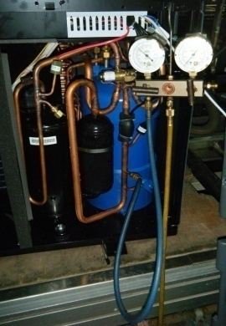
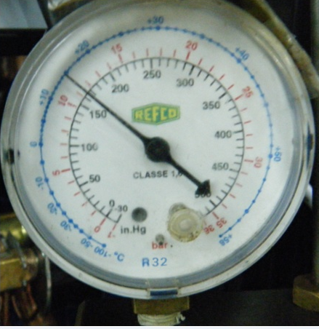
Normal ambient temp:
When detecting gas, heat pump must be running at least 5 minutes, the pressure value will vary according
to air temp, please refer to pressure data form.
When pressure value is 10% lower than reference pressure value, gas should be insufficient.
Low ambient temp:
If heat pump is frosting, and it is not clean after defrosting, gas should be insufficient.
Warning: The operation must be carried by technician

Slide 91
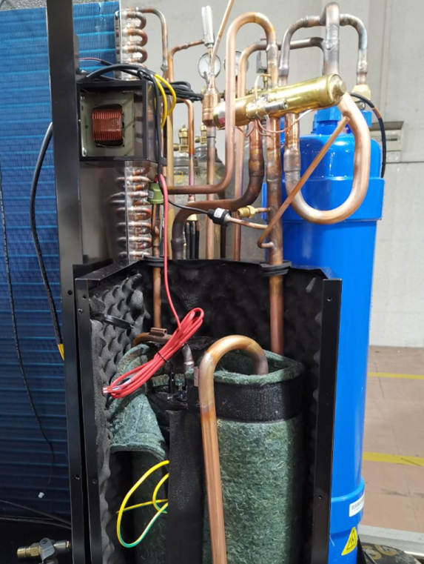
B. Leakage point detecting
1. Soap water detecting:
1). Get a bowl of water and put in some soap or washing powder, stir it until melted or bubbles appear.
2). Use brush to soak soap water and apply it to the pipelines.
(mainly on welding points)
If there are bubbles coming out continuously, it means gas leakage is at this position.
2. Use professional leakage detection device.

Slide 92
C. Leakage repair and gas refilling
1) Professional welder repairs leakage
2) Gas refilling (steps)
Fill gas (refer to nameplate gas weight)
Check if gas pressure is normal
Vacuumize
Note: Please fill gas from low pressure valve.

Slide 93
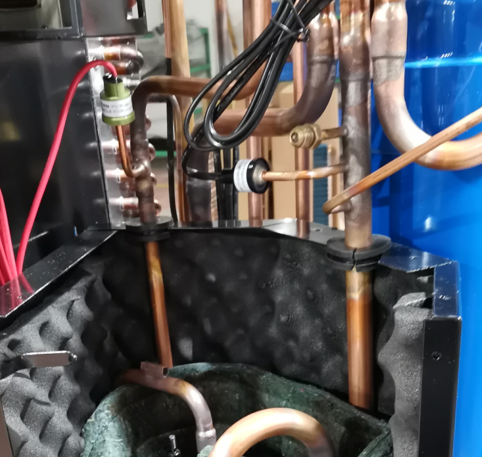

Step 3. Check low pressure switch
Check low pressure switch if it is working normally, If resistance value is 0 or very close to 0, that means it is OK. If resistance value is infinite(display OL), that means low pressure switch fail.
Low pressure switch

Slide 94
E8 solution
Display E8
（High exhaust temp protection）
1. Installation condition
2. Check water pump
3. Detect gas leakage
4. Gas exhaust temp sensor

Slide 95
Step 1. Check installation condition, refer to E1.
Step 2. Check water pump, refer to E1.
If it is blocked, it will lead to water inlet and outlet temp too high, and gas exhaust temp overheat, then E8 display.
Step 3. Gas leakage detecting, refer to E2.

Slide 96




Step 4. Replace Gas exhaust temp sensor.
Check if gas exhaust temp sensor is well connected, if well connected, replace gas exhaust temp sensor.
Gas exhaust temp sensor port: AIN5（Red color）
（White color） Gas exhaust temp sensor position: Above compressor

Slide 97
EA Solution
Display EA
Evaporator overheat protection
(only at cooling mode )
1. Installation condition
2. Fan is broken or not
3. Replace fan motor
Warning: When conducting below operation, heat pump must be powered off !

Slide 98

Step 1. Check installation condition, refer to E1.
Step 2. If fan not run, check if fan is broken, if broken, replace it.
If fan is good, go to step 3.

Slide 99
Step 3: If fan not run, replace fan motor.
Fan motor

Slide 100
3. Water system failure
Error code | Description | Solution
E7 | Water outlet temp too high or too low protection | A. Water outlet temp B. Water pump C. Water outlet temp sensor D. Replace Integrated board/PC board (for three-phase models)

Slide 101
E7 solution
Display E7
Water outlet temp too high or too low protection
1. Water outlet temp
2. Water pump
3. Water outlet temp sensor
4. Replace Integrated board/PC board
Warning: When conducting below operation, heat pump must be powered off !

Slide 102
Step 1: Check if water outlet temp is in normal range.
If the water outlet temp is too big(heating), or too small (cooling)
Water outlet temp≤ 2 ℃, when cooling
Water outlet temp≥ 55 ℃, when heating
If water temp is normal, go to step 2.

Slide 103
Step 2: Check if water pump is working normally.
Water pump：
A. Check if water pump is running well.
B. Check if water flow is sufficient.
C. Check if water pump is blocked.
D. Check if water pump valve is fully opened.
If water flow volume is normal, go to step 3.

Slide 104



Step 3: Check if water outlet temp sensor is well connected, if well connected, replace sensor.
Single phase
Water outlet temp sensor terminal: AIN2 (Brown)
Three-phase
Water outlet temp sensor (brown label)
If well connected, go to step 4.

Slide 105
Step 4: Replace Integrated board.
Integrated board
PC board

Slide 106
4. Temperature sensor failure
Error code | Description | Solution
P1 | Water inlet temp sensor failure | A. Wiring B. Replace temp sensor C. Replace Integrated board/PC board
P2 | Water outlet temp sensor failure
P3 | Gas exhaust temp sensor failure
P4 | Evaporator coil pipe temp sensor failure
P5 | Gas return temp sensor failure
P6 | Cooling coil pipe temp sensor failure
P7 | Ambient temp sensor failure
P8 | Cooling plate temp sensor failure | Replace Integrated board/Inverter board
P9 | Current sensor failure | Replace Integrated board/Inverter board

Slide 107
Temp sensor error code
The color of plug on sensor should be match with the color of plug on Integrated board
P1—AIN1 inlet temp sensor （Blue）
P2—AIN2 outlet temp sensor （ Brown ）
P3—AIN5 gas exhaust temp sensor （ Red ）
P4—AIN3 evaporator coil pipe temp sensor （ White ）
P5—AIN6 gas return temp sensor （ Black ）
P6—AIN4 cooling coil pipe temp sensor （ Green ）
P7—AIN7 ambient temp sensor （ Yellow ）
P8—on inverter board
P9— on inverter board(single phase)
or power filter plate (3phase)

Slide 108
P1/2/3/4/5/6/7 solution
Display P1/2/3/4/5/6/7
Temp sensor failure
1. Wiring
2. Replace temp sensor
3. Replace Integrated board/PC board
If wire checking is ok, replace temp sensor.
If still error, replace PC board .
Warning: When conducting below operation, heat pump must be powered off !

Slide 109

1. Wiring of P1 (Single phase model)
Water inlet temp sensor terminal on Integrated board: AIN1 (Blue color)
Check if water inlet temp sensor wiring is well connected.
Water inlet temp sensor position: Down side of heat exchanger

Slide 110
2. Wiring of P2 (Single phase model)
Water outlet temp sensor terminal on Integrated board: AIN2（Brown）
Check if water outlet temp sensor wiring is well connected to Integrated board(As above photo)
Water outlet temp sensor position: Above heat exchanger

Slide 111
3. Wiring of P3
Gas exhaust temp sensor terminal on Integrated board: AIN5(red)
Check if gas exhaust temp sensor wiring is well connected.
Gas exhaust temp sensor position:
On gas exhaust copper pipe

Slide 112

4.Wiring of P4
Evaporator coil pipe temp sensor on PC board: AIN3(White color)
Please check if heating coil pipe temp sensor wiring is well connected.
Evaporator coil pipe position: the bottom of evaporator coil pipe

Slide 113
5.Wiring of P5
Gas return temp sensor terminal on Integrated board: AIN6(black color)
Please check if gas return temp sensor wiring is well connected.
Gas return temp sensor position: near low pressure switch

Slide 114

6. Wiring of P6
Cooling coil pipe temp sensor terminal on Integrated board: AIN4(green color)
Cooling coil pipe temp sensor position: on the top of heat exchanger
Please check if Cooling coil pipe temp sensor wiring is well connected.

Slide 115

7. Wiring of P7
Ambient temp sensor terminal on Integrated board: : AIN7(yellow color)
Check if ambient temp sensor wiring is well connected.
Ambient temp sensor position

Slide 116
P8 Solution
Display P8
Cooling plate temp sensor failure
Single phase/Three phase
Replace Integrated board
Single phase model
Three-phase model
Replace Inverter board
Warning: When conducting below operation, heat pump must be powered off !

Slide 117
Single phase model:
Replace Integrated board
Integrated board

Slide 118
Three-phase model:
Replace Inverter board.
Inverter board

Slide 119
P9 Solution
Display P9
Current inductor failure
Single phase model/Three phase model
Replace Integrated board
Single phase model
Three-phase model
Replace Inverter board
Warning: When conducting below operation, heat pump must be powered off !

Slide 120
Single phase model:
Replace Integrated board
Integrated board

Slide 121
Three-phase model:
Replace Inverter board.
Inverter board

Slide 122
5. Non-failure Protection
Error code | Description | Solution
E3 | No water protection | A. Water pump B. Integrated board/PC board wiring C. Water flow switch
E5 | Power supply excesses operation range (Not failure) | A. Recover when back to the normal power B. Replace Integrated board/PC board
E6 | Excessive temp difference between inlet and outlet water (Insufficient water flow protection) | Check water pump
Eb | Ambient temperature too high or too low protection (not failure) | Out of application range
Ed | Anti-freezing reminder (not failure ) | Wait for automatic recovery

Slide 123
E3 solution
Display E3
No water protection
1. Water pump
2. Check Integrated board wiring
3. Water flow switch
Single phase model
Three phase model
1. Water pump
2. Check PC board wiring
3. Water flow switch
Warning: When conducting below operation, heat pump must be powered off !

Slide 124
Step 1: Check if water pump is working normally.
Water pump：
A. Check if water pump is running well.
B. Check if water flow is sufficient.
C. Check if water pump is blocked.
D. Check if water pump valve is fully opened.
If water flow volume is normal, go to step 2.

Slide 125
Step 2: Check if wiring between Integrated board and water flow switch are well connected. (Single phase model)
water flow switch terminal DIN3 (blue color)
If well connected, go to step 3.

Slide 126
Check if wiring between PC board and water flow switch are well connected.
(Three-phase model)
water flow switch terminal DIN3
If well connected, go to step 3.

Slide 127


Step 3: Replace water flow switch.
Water flow switch

Slide 128




Water flow switch installation
Arrow point to water outlet direction
Water outlet
Check if there is O-ring seal in the new water flow switch
Insert water flow switch as photo, pay attention to the arrow direction.
Hold steady up-side,
screw tight water flow switch with pliers。
After installation

Slide 129
Display E5
(Not failure, power supply excesses operation range)
1. Recover when back to normal power
2. Replace Integrated board
Single phase
Three-phase model
1. Recover when back to normal power
2. Replace PC board
E5 Solution
Single Phase: Display E5 when Power≤170V or ≥270V ；
180V~255V recover
Three Phase: Display E5 when Power≤330V or ≥530V ；
345V~500V recover

Slide 130
Step 1: Check if the power is abnormal (Power≤170V or ≥270V ), if abnormal, wait till it is recovered(180V~255V) and restart the unit. If power normal, go to step 2.
Step 2: Replace Integrated board.
(For single phase model)
Integrated board

Slide 131
Step 1: Check if the power is abnormal(Power ≤330V or ≥530V ), if abnormal, wait till it is recovered(345V~500V) and restart the unit.
Step 2: Replace PC board. (For three-phase model)
PC Board

Slide 132
E6 solution
Display E6
Excessive temp difference between water inlet & outlet protection
1. Check water pump
2. Check sensor of inlet and outlet water temp are well connected
3. Replace Integrated board/PC board(Three-phase)
Water temp difference between inlet & outlet excess 10℃.

Slide 133
Step 1: Check if water pump is working normally.
Water pump：
A. Check if water pump is running well.
B. Check if water flow is sufficient.
C. Check if water pump is blocked.
D. Check if water pump valve is fully opened.
If water flow volume is normal, go to step 2.

Slide 134
Step 2: Check if sensor of inlet and outlet water temp are well connected.
Water inlet temp sensor (blue label)
Water outlet temp sensor (brown label)
If well connected, go to step 3.

Slide 135
Step 3: Replace Integrated board (For single phase model)
Integrated board

Slide 136
Replace PC board. (For three phase model)
PC board

Slide 137
Eb Solution
Display Eb（Not failure）
Ambient temp too high or too low protection
Ambient temp＜-15℃
or＞43 ℃
Solution: Wait until air temp is -15~43 ℃.

Slide 138
Ed Solution
Display Ed (not failure)
Anti-freezing reminder
Anti-freezing reminder
Display Ed: When water inlet temp ≤ 2 ℃ and air temp ≤ 0 ℃.
Status: Heat pump automatically start running at heating mode.
Recover: When water inlet temp ≥15℃or air temp ≥ 1 ℃.
Status: Heat pump recover to be powered off or standby.
Note：Only when heat pump is powered on and water pump is running, heat pump can enter anti-freezing status, if there is no water goes through heat pump, then E3 will display, heat pump will stop.
Ed displays only if heat pump is standby or turned off but with power on.

Slide 139
Common failure

Slide 140
HP no heating
(For single phase model)
Check HP running status
1.No condensate water/fan blows out normal temp wind
Check if there is any leakage, if yes, refill gas
2. Fan does not work
A. Fan
B. Integrated board
C. Fan motor
3. Compressor does not work
A. Integrated board
B. Compressor

Slide 141


Check HP running status
If there is no error code, pls check below step by step:
1). Check if there is condensate water, as normally the running HP is with condensate water.
2). Check the wind blows out from HP: under heating mode, the wind is cold, under cooling mode, the wind is warm.
3). Check if fan is running.
4). Check if compressor is running.
If not belong to above situation:
1. Please power off the HP at least 5 minutes , and then restart it
2. Please set pool temp to 35 °C

Slide 142
1.If no condensate water, or fan blows out normal temp wind, please check if gas leakage and recharge
Check low pressure gas value ( Refer to E2)
Low pressure valve for reference
 | Air ℃ | Humidity℃ | Inlet water temp ℃ | Outlet water temp℃ | Capacity | Low pressure（Mpa）
Heating | 15 | 12 | 26 | 28 | 100% Capacity | 0.67-0.8
 |  |  |  |  | 80% Capacity | 0.8-1.0
Cooling | 35 | 24 | 28 | 26 | 100% Capacity | 0.9-1.0

Slide 143

2. Fan is not running
A. Check if the fan is broken, if any damage replace the fan
Fan
If the problem still exist, go to the next step

Slide 144
B. Replace Integrated board
Integrated board
If the problem still exist, go to the next step

Slide 145

C. Check if the fan motor is failure, if failure, please replace fan motor.
Fan motor
If the problem still exist, go to the next step

Slide 146
3. compressor is not running
A. Replace Integrated board
Integrated board
B. If problem still exist, go to compressor detection:
Please detect the compressor in below 2 ways.
If either occur, please replace compressor.

Slide 147


1) Check if the circuit of compressor is failure :
The resistance is the same between any two terminals. If one of them is big different, that means compressor fail in circuit, please replace compressor.
Check if the resistance value between any two of these three terminals are the same. If not, check the compressor itself.
U
W
V
2.Three terminals of compressor
U(R) -Terminal of running winding
W(C) -Public terminals of two windings.
V(S)-Terminal of startup winding
1. Please adjust resistance grade to 200 Ω before use.

Slide 148






Detection result:
As left photo, if the resistance between any two terminals of compressor, that means the compressor is ok.
But if one of them is zero or infinite, that means failure, please replace compressor.
The above operation must be carried out when power off!

Slide 149

2) Check if the compressor get stuck by clamp meter.
1, If the compressor has any special sound
2, If no special sound, please detect the running current by clamp meter, if it
is several times more than rate current, please replace compressor.
Detection of running current:
1,When power off, adjust clamp meter to applicable grade, and clamp the power cord of terminal L.
2, When power on, the detected current is several times more than rated current, and no cold wind blow out from fan, that means compressor get stuck. Please turn off the unit and replace compressor quickly to avoid potential safety hazard

Slide 150
HP no heating
(For three-phase model)
Check HP running status
1.No condensate water/fan blows out normal temp wind
Check if there is any leakage, if yes, refill gas
2. Fan does not work
A. Fan
B. PC board
C. Fan motor
3. Compressor does not work
A. Inverter board
B. Compressor
D. Inverter board

Slide 151


Check HP running status
If there is no error code, pls check below step by step:
1). Check if there is condensate water, as normally the running HP is with condensate water.
2). Check the wind blows out from HP: under heating mode, the wind is cold, under cooling mode, the wind is warm.
3). Check if fan is running.
4). Check if compressor is running.
If not belong to above situation:
1. Please power off the HP at least 5 minutes , and then restart it
2. Please set pool temp to 35 °C

Slide 152
1.If no condensate water, or fan blows out normal temp wind, please check if gas leakage and recharge
A. Check low pressure gas value
High pressure and low pressure valuve for reference
 | Air ℃ | Humidity℃ | Inlet water temp ℃ | Outlet water temp℃ | Capacity | High pressure（Mpa） | Low pressure（Mpa）
Heating | 15 | 12 | 26 | 28 | 100% Capacity | 2.2-2.4 | 0.65-0.8
 |  |  |  |  | 80% Capacity | 2.0-2.2 | 0.8-0.9
Cooling | 35 | 24 | 28 | 26 | 100% Capacity | 3.0-3.2 | 0.9-1.0
B. If low pressure gas value is far more lower than the reference value, then it can be
considered to be gas insufficient, gas leakage checking is required.

Slide 153

2. Fan motor is not running
A. Check the fan is running properly or broken
Fan
If fan is fine, go to the next step

Slide 154
B. Replace PC board
PC Board
Terminal: JP1
Pay attention: When replace PC Board, Terminal JP1 must be connected with a small black cover, which is the same as original PC board.
If the problem still exist, go to the next step.

Slide 155
C. Check if the fan motor is failure, if failure, please replace fan motor.
Fan motor
If the problem still exist, go to the next step.

Slide 156
D. Replace the inverter board
Inverter Board

Slide 157
3. Compressor is not running
A. Replace the inverter board
Inverter Board
B. If problem still exist, go to compressor detection:
Please detect the compressor in below 2 ways.
If either occur, please replace compressor.

Slide 158


1) Check if the circuit of compressor is failure :
The resistance is the same between any two terminals. If one of them is big different, that means compressor fail in circuit, please replace compressor.
Check if the resistance value between any two of these three terminals are the same. If not, check the compressor itself.
U
W
V
1. Please adjust resistance grade to 200 Ω before use.
2.Three terminals of compressor
U(R) -Terminal of running winding
W(C) -Public terminals of two windings.
V(S)-Terminal of startup winding

Slide 159



Detection result:
As left photo, if the resistance between any two terminals of compressor, that means the compressor is ok.
But if one of them is zero or infinite, that means failure, please replace compressor.
The above operation must be carried out when power off!

Slide 160
2)Check if the compressor get stuck by clamp meter.
1, If the compressor has any special sound
2, If no special sound, please detect the running current by clamp meter, if it
is several times more than rate current, please replace compressor.
Detection of running current:
1,When power off, adjust clamp meter to applicable grade, and clamp the power cord of terminal L.
2, When power on, the detected current is several times more than rated current, and no cold wind blow out from fan, that means compressor get stuck. Please turn off the unit and replace compressor quickly to avoid potential safety hazard
Note: pls refer to the rated current on the nameplate

Slide 161
Defrosting (not failure)
(For single phase model)
1. Check installation environment
2. If the heat pump can defrost (compulsory defrosting)
3. Check low pressure value
4. Adjust parameter
If the heat pump cannot defrost, please replace Integrated board.
Detect leakage and refill gas

Slide 162
Step 1: Check the installation is good enough for air circulation.
1) Check if heat pump is installed according to required distance；
2) Check if heat pump evaporator fins are blocked
If installation condition is good, go to step 2.

Slide 163
Step 2. Compulsory defrosting
A. Touch controller compulsory defrosting instruction
When touch controller lit up under heating code, press and continuously for 5 seconds to start up compulsory defrosting. on top left corner of screen flashing,
will stop flashing after defrosting.
Note: Interval will be 30/35 minutes between two compulsory defrosting
Replace Integrated board if compulsory defrosting cannot start up
Integrated board
If installation condition is good, go to step 3.

Slide 164
Step 3.If no condensate water, or fan blows out normal temp wind, please check if gas leakage and recharge
A. Check low pressure gas value ( Refer to E2)
low pressure valve for reference
 | Air ℃ | Humidity℃ | Inlet water temp ℃ | Outlet water temp℃ | Capacity | Low pressure（Mpa）
Heating | 15 | 12 | 26 | 28 | 100% Capacity | 0.65-0.8
 |  |  |  |  | 80% Capacity | 0.8-0.9
Cooling | 35 | 24 | 28 | 26 | 100% Capacity | 0.9-1.0
If installation condition is good, go to step 4.

Slide 165

Step 4 Adjust internal parameter P2 and P5
Press and together for 5 seconds to enter “parameter checking” status, the parameters will show up like “P0 2”.
Use and to select different parameters. Check P2 value, if it’s not 30, press to enter “Parameter adjusting” status, then use and to set P2 value to 30, then press to quit “Parameter adjusting” status. Same way to check P5 value and set it to 18.
Press to quit “Parameter checking”.

Slide 166
Defrosting (not failure)
(For three-phase model)
1. Check installation environment
2. If the heat pump can defrost (compulsory defrosting)
3. Check low pressure valve
4. Adjust parameter
If the heat pump cannot defrost, please replace PC board
Detect leakage and refill gas

Slide 167
Step 1: Check the installation is good enough for air circulation.
1) Check if heat pump is installed according to required distance；
2) Check if heat pump evaporator fins are blocked
If installation condition is good, go to step 2.

Slide 168
Step 2. Compulsory defrosting
A. Touch controller compulsory defrosting instruction
When touch controller lit up under heating code, press and continuously for 5 seconds to start up compulsory defrosting. on top left corner of screen flashing,
will stop flashing after defrosting.
Note: Interval will be 30/35 minutes between two compulsory defrosting
Note: Interval will be 30/35 minutes between two compulsory defrosting
PC Board
Replace PC board if compulsory defrosting can’t start up
If installation condition is good, go to step 3.

Slide 169
Step 3.If no condensate water, or fan blows out normal temp wind, please check if gas leakage and recharge
A. Check low pressure gas value
High pressure and low pressure valuve for reference
 | Air ℃ | Humidity℃ | Inlet water temp ℃ | Outlet water temp℃ | Capacity | High pressure（Mpa） | Low pressure（Mpa）
Heating | 15 | 12 | 26 | 28 | 100% Capacity | 2.2-2.4 | 0.65-0.8
 |  |  |  |  | 80% Capacity | 2.0-2.2 | 0.8-0.9
Cooling | 35 | 24 | 28 | 26 | 100% Capacity | 3.0-3.2 | 0.9-1.0
B. If low pressure gas value is far more lower than the reference value, then it can be
considered to be gas insufficient, gas leakage checking is required.
If installation condition is good, go to step 4.

Slide 170
Step 4. Adjust internal parameter P2 and P5
Press and together for 5 seconds to enter “parameter checking” status, the parameters will show up like “P0 2”.
Use and to select different parameters. Check P2 value, if it’s not 30, press to enter “Parameter adjusting” status, then use and to set P2 value to 30, then press to quit “Parameter adjusting” status. Same way to check P5 value and set it to 18.
Press to quit “Parameter checking”.

Slide 171
Controller no display
（For single phase model）
Normal power supply to PC board
Abnormal power supply to PC board
1. Wiring
2. Controller
3. Integrated board
With power supply but having short circuit
No power supply for PC board
Fan motor and Integrated board
Wiring of power supply

Slide 172

Check if power supply on Integrated board is normal or not
As below picture, check if two power lights of Integrated Board are on ,
If two lights are on, go to step 1.
If two lights are off, or one of them are off, go to step 2.
Power lights

Slide 173
Step 1. Replace controller
Check if WCTIL wiring
on Integrated board is well
connected
If well connected and controller has no display, replace controller.
If the problem still exist, go to B

Slide 174
B. Replace Integrated board
Integrated board
If the problem still exist, go to the next step

Slide 175
Step 2. If one of LED lights (diode) are off , then disconnect the wiring between Integrated board and DC motor, to see if controller can display normally.
Terminal DCFM
Note:
If display, then replace the DC fan motor and re-wiring.
If the problem still exist, go to the next step

Slide 176

3. Power supply
If two power lights are off on PC Board, check if power suppy is normal.
Check if voltage is 230V between AC-L and AC-N.
Note:
If no power supply, check if the power supply from Power Terminal is
normal. Find where power fail and fix it.

Slide 177
Controller no display
（For three-phase model）
Normal power supply to PC board
Abnormal power supply to PC board
1. Wiring
2. Controller
3. PC board
With power supply but having short circuit
No power supply for PC board
Fan motor and inverter board
Wiring of power supply

Slide 178

Check if power supply on PC board is normal.
As below picture, check if two power lights of PC board are on.
If two lights are on, go to step 1.
If two lights are off, or one of them are off, go to step 2.
Power lights

Slide 179
Step 1: Normal power supply to PC board.
A: Check wiring
Check if wiring between controller and PC board is well connected.
WCTIL wiring on PC board(white color)
The wiring connector between controller and PC board: above heat exchanger
If well connected, go to B.

Slide 180
B: Replace controller.
Controller
If problem still exist, go to C.

Slide 181
C: Replace PC board.
PC board

Slide 182
2. Abnormal power supply to PC board.
A. If one of LED lights (diode) are off, then disconnect the wiring between PC board and fan motor module, check if the “off” light is on and controller can display normally.
DCFM: 5pin terminal for fan driver module
LED Light (diode)
Note:
If the LED light is on and display normal, replace the fan motor module.
If the LED light is still off, go to B.

Slide 183
B. Disconnect the wiring between PC board and Inverter board, check if the “off” light is on and controller can display normally.
Terminal CN1
Note:
If the LED light is on and display normal, replace the Inverter board.

Slide 184
C. Power supply
If two power lights are off on PC Board, check if power suppy source or wiring is normal.
Check if voltage is 230V between AC-L and AC-N.
Note:
If no power supply, check if the power supply from Power Terminal is
normal, if the power light of inverter board is on.

Slide 185
The End

